Slide 1

AMAZON SALES Analysis
Lipsa Priyadarshini Barik

Slide 2
Visions
Problem Statement
Objective
Develop a Report by Extracting-Transforming-Loading of data which contains Sales trend with respect to Year, Month, Quarter and find Some relationships through data to understand and Analyze the Facts.
Sales management has gained importance to meet increasing competition and the need for improved methods of distribution to reduce cost and to increase profits. Sales management today is the most important function in a commercial and business enterprise.

Slide 3
Insights
Having Insights of Amazon sales data for 2011 to 2017.
12 types of products
7 Regions and
75 Countries.
400+ Costumers.

Slide 4
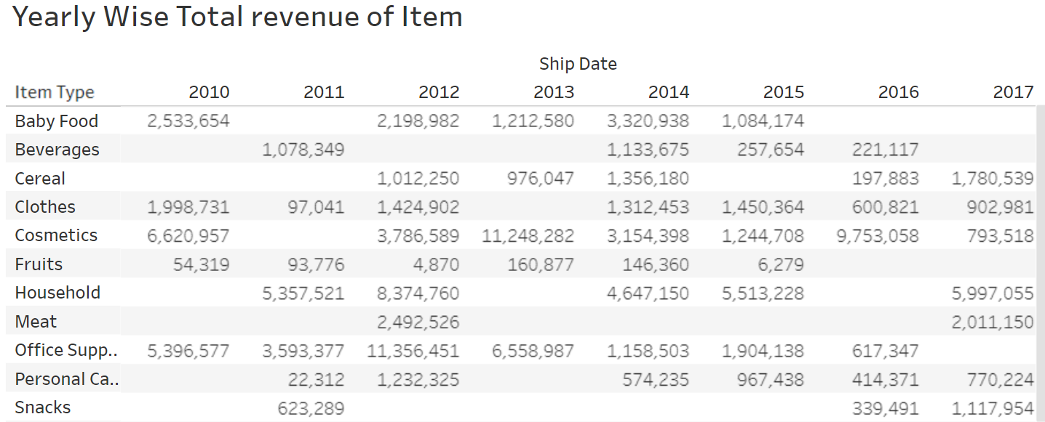
Yearly Wise item Revenue

Slide 5
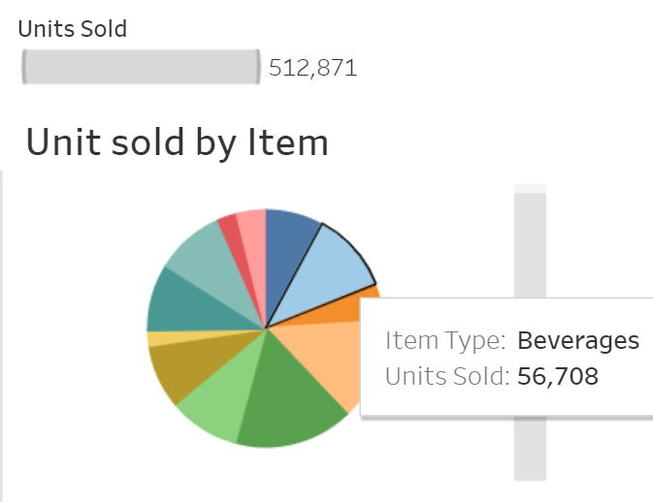
Unit Sold By Item

Slide 6
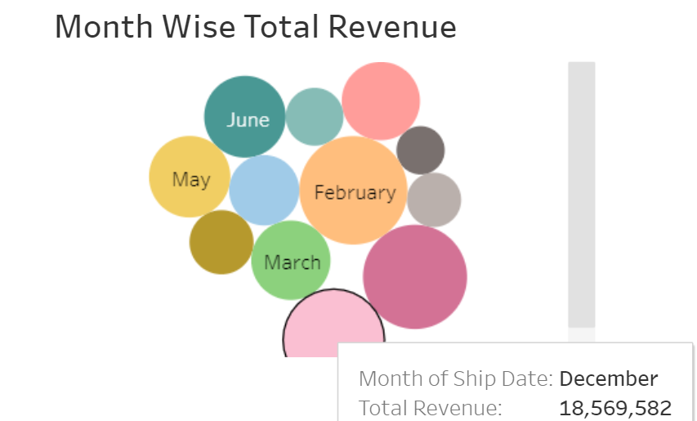
Monthly Revenue

Slide 7
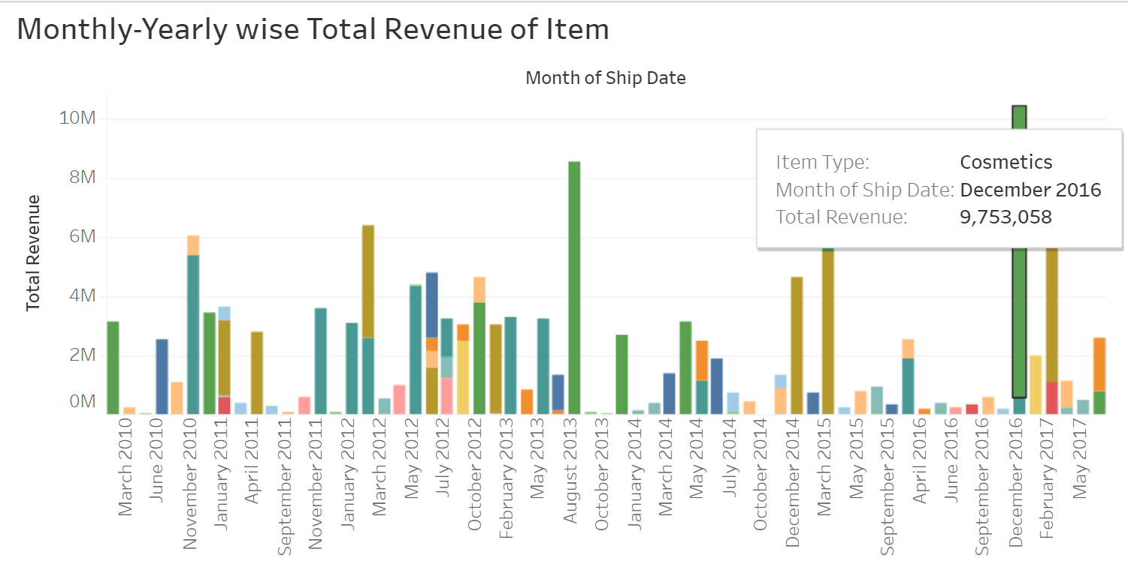
Monthly- Yearly wise Revenue

Slide 8
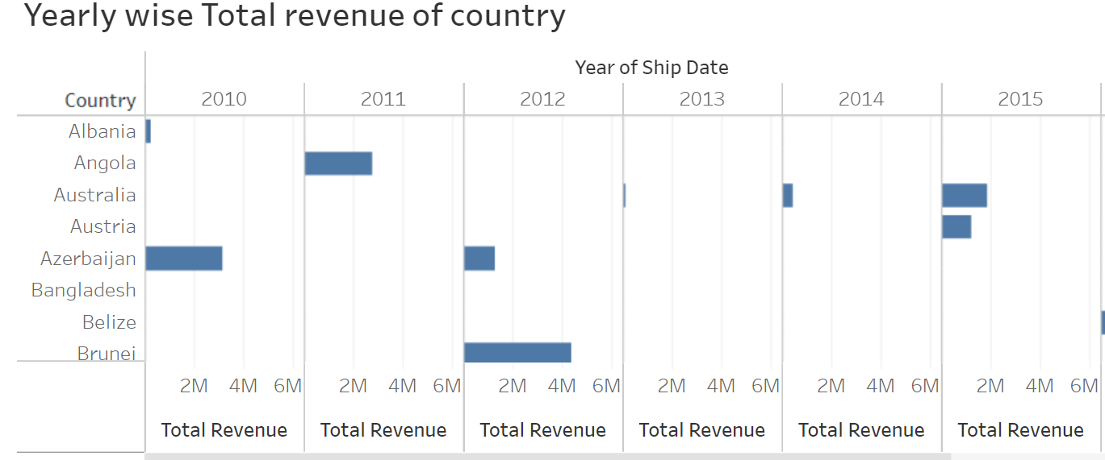
Yearly wise Revenue Of Countries

Slide 9
Conclusion
2016 had the highest Revenue of 9,753,058 in the month of December, with the product type – Cosmetics.
If we observe the monthly insights of 2010 to 2017, found that February is the highest revenue record.
There are 5,12,871 total number of unit sale throughout the 2010-2017.
The sales for the US are highest among all countries and lowest in Albania.
High Top Cosmetics are the highest selling products in domestic and international markets.
Here is my Tableau Dashboard Link: https://public.tableau.com/app/profile/lipsa.barik/viz/AmazonSalesDashboard_17084062408230/Dashboard1?publish=yes

Slide 10
THANK YOU

